Slide 1
BOOST Converter
GT ECE academic lab
Slides by Zachary Chan

Slide 2
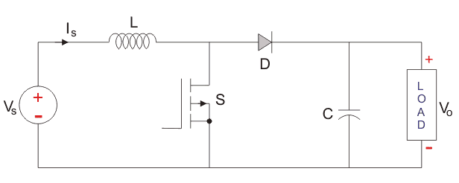
OVerview
Type of switch mode power converter, meaning it has a switching transistor
Also known as DC-DC Step Up Converter because it increases the voltage of a DC source (9V battery but boosted to 50V)
Simple circuitry that includes an inductor, diode, transistor, capacitor, and clock signal
Can be built homemade or come premade

Slide 3
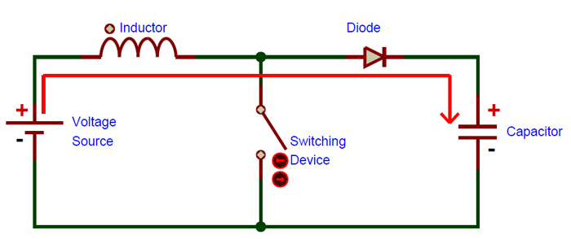
Working principle
The clock signal switches on an off the transistor which redirects the current
In the off state, the current flows from the battery into the capacitor
Voltage of the source equals the voltage of the capacitor

Slide 4
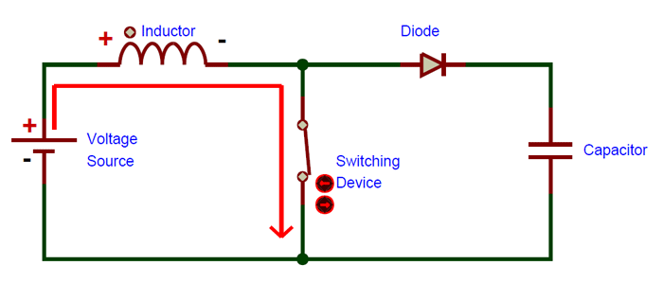
Working Principle
When the clock switches the transistor on, current flows through the transistor rather than through the diode
The current increases slowly because the inductor resists the change in current by generating a potential difference opposite to the battery
There is no immediate short circuit or danger here because the inductor makes the current increases slowly, preventing melting or heating

Slide 5
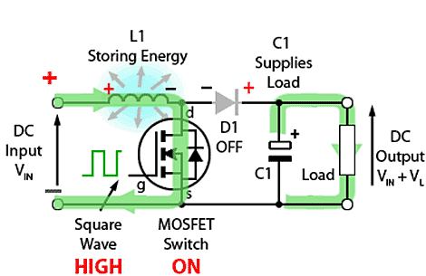
Working Principle
When a load is connected in parallel to the capacitor and the transistor is in the on state, the capacitor discharges, powering the load

Slide 6
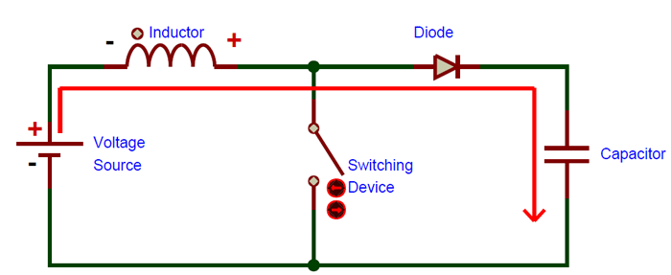
Working Principle
When the clock turns the transistor off again, current flows through the diode into the capacitor again
The circuit has higher impedance, decreasing current
The inductor opposes reduction in current, so it creates a voltage opposite to before
Voltages in series increase the capacitor voltage

Slide 7
Clock Control
The output voltage depends on the duty cycle of the clock signal
A higher duty cycle results in a higher output current
The clock signal is important because if the transistor is on for too long, the circuit will short, causing the inductor and transistor to break
Common clocks are 555 Timer and Arduino PWM controlled with a potentiometer

Slide 8
Applications
DC power supplies
Regenerative braking for DC motors
Any applications with a space constraint such that adding batteries in series is not possible as a method of increasing voltage

