Slide 1
Ferrite Core inductor
GT ECE academic lab
Slides by Zachary Chan

Slide 2
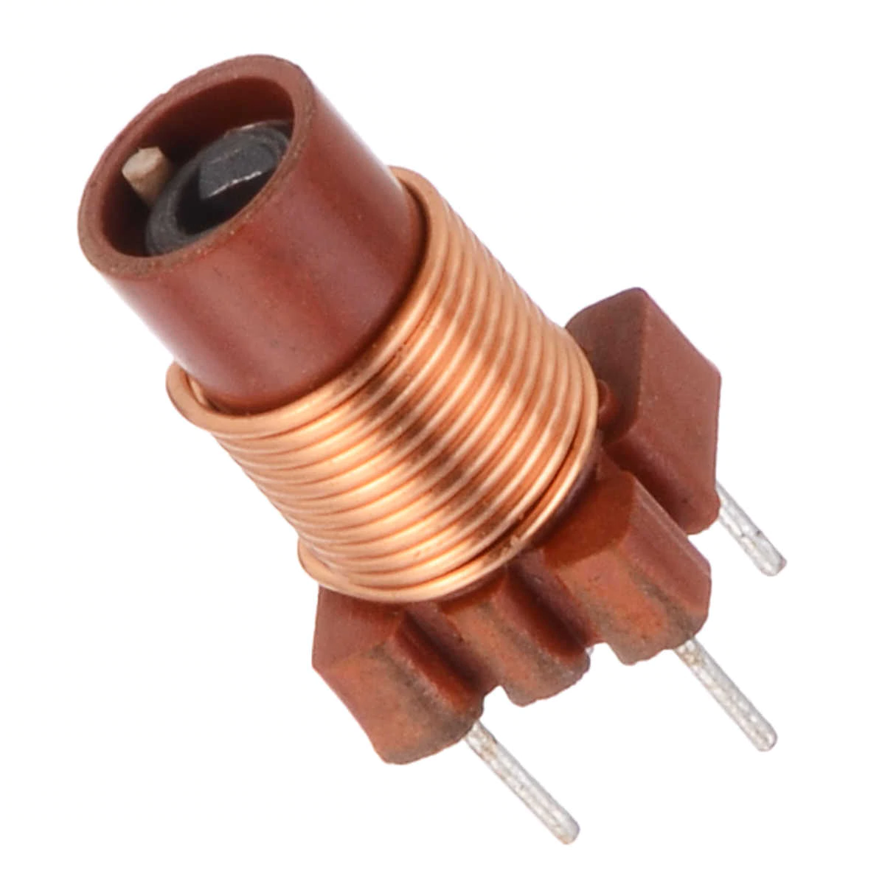
overview
Ferrites are non-conductive, ceramic iron-based material
Made from metals like copper, magnesium, nickel, and/or zinc along with iron
They are ferromagnetic because of their iron content, but they are not completely iron, so core losses are reduced
Smaller than iron core inductors

Slide 3
Soft Ferrite vs Hard ferrite
Soft ferrites can change the polarity of their magnetic field without a significant amount of energy needed
Hard ferrites are permanent magnets, so they retain their polarity after an external field is removed
Soft ferrites are used more in inductors because they can change their field polarity easily

Slide 4
Applications
High frequency applications
Have higher inductance than air core inductors but less core loss than iron core inductors
Still has core loss, but less than iron
Switch mode power supplies
IF and RF (intermediate frequency and radio frequency)

