Slide 1
Hall Effect Sensor
GT ECE ACADEMIC labs
SLIDES BY Zachary Chan

Slide 2
overview
Hall Effect sensors can detect the strength of a magnetic field
They can be used for current sensing and rotational speed in motors and as magnetic proximity sensing
There are different types of Hall effect sensors:
Digital vs Analog output
Unipolar vs Bipolar sensing capabilities (whether the sensor can detect only North or only South or Both)

Slide 3
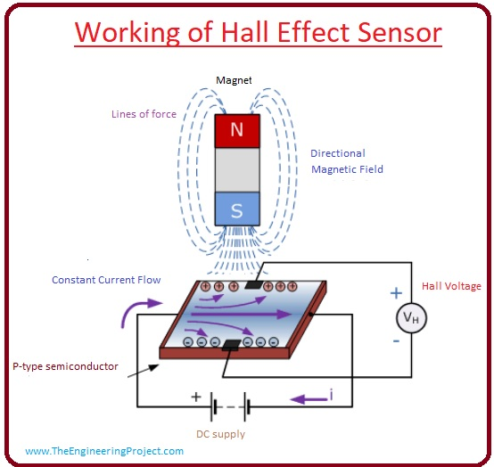
Hall effect
The Hall Effect occurs when a magnetic field is placed near a semiconductor plate with current flowing through it
The magnetic force created by the magnetic field forces electrons towards one side of the plate, creating a potential difference between the two sides of the plate

Slide 4
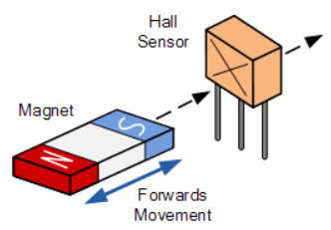
Head on detection
Head on detection involves a magnetic field moving towards or away from the face of the sensor
Useful for proximity sensing

Slide 5
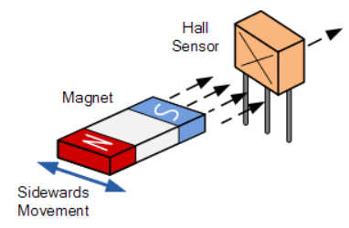
Sideways detection
Sideways detection involves a magnetic field moving parallel to the face of the sensor
This type of detection is useful for detecting the rotational speed of a motor and for current sensing

