Slide 1
Linear Voltage Regulator
GT ECE academic lab
Slides by Zachary Chan

Slide 2
Overview
Linear voltage regulator is a component that takes an input voltage and outputs a lower voltage
The extra energy is dissipated as heat

Slide 3
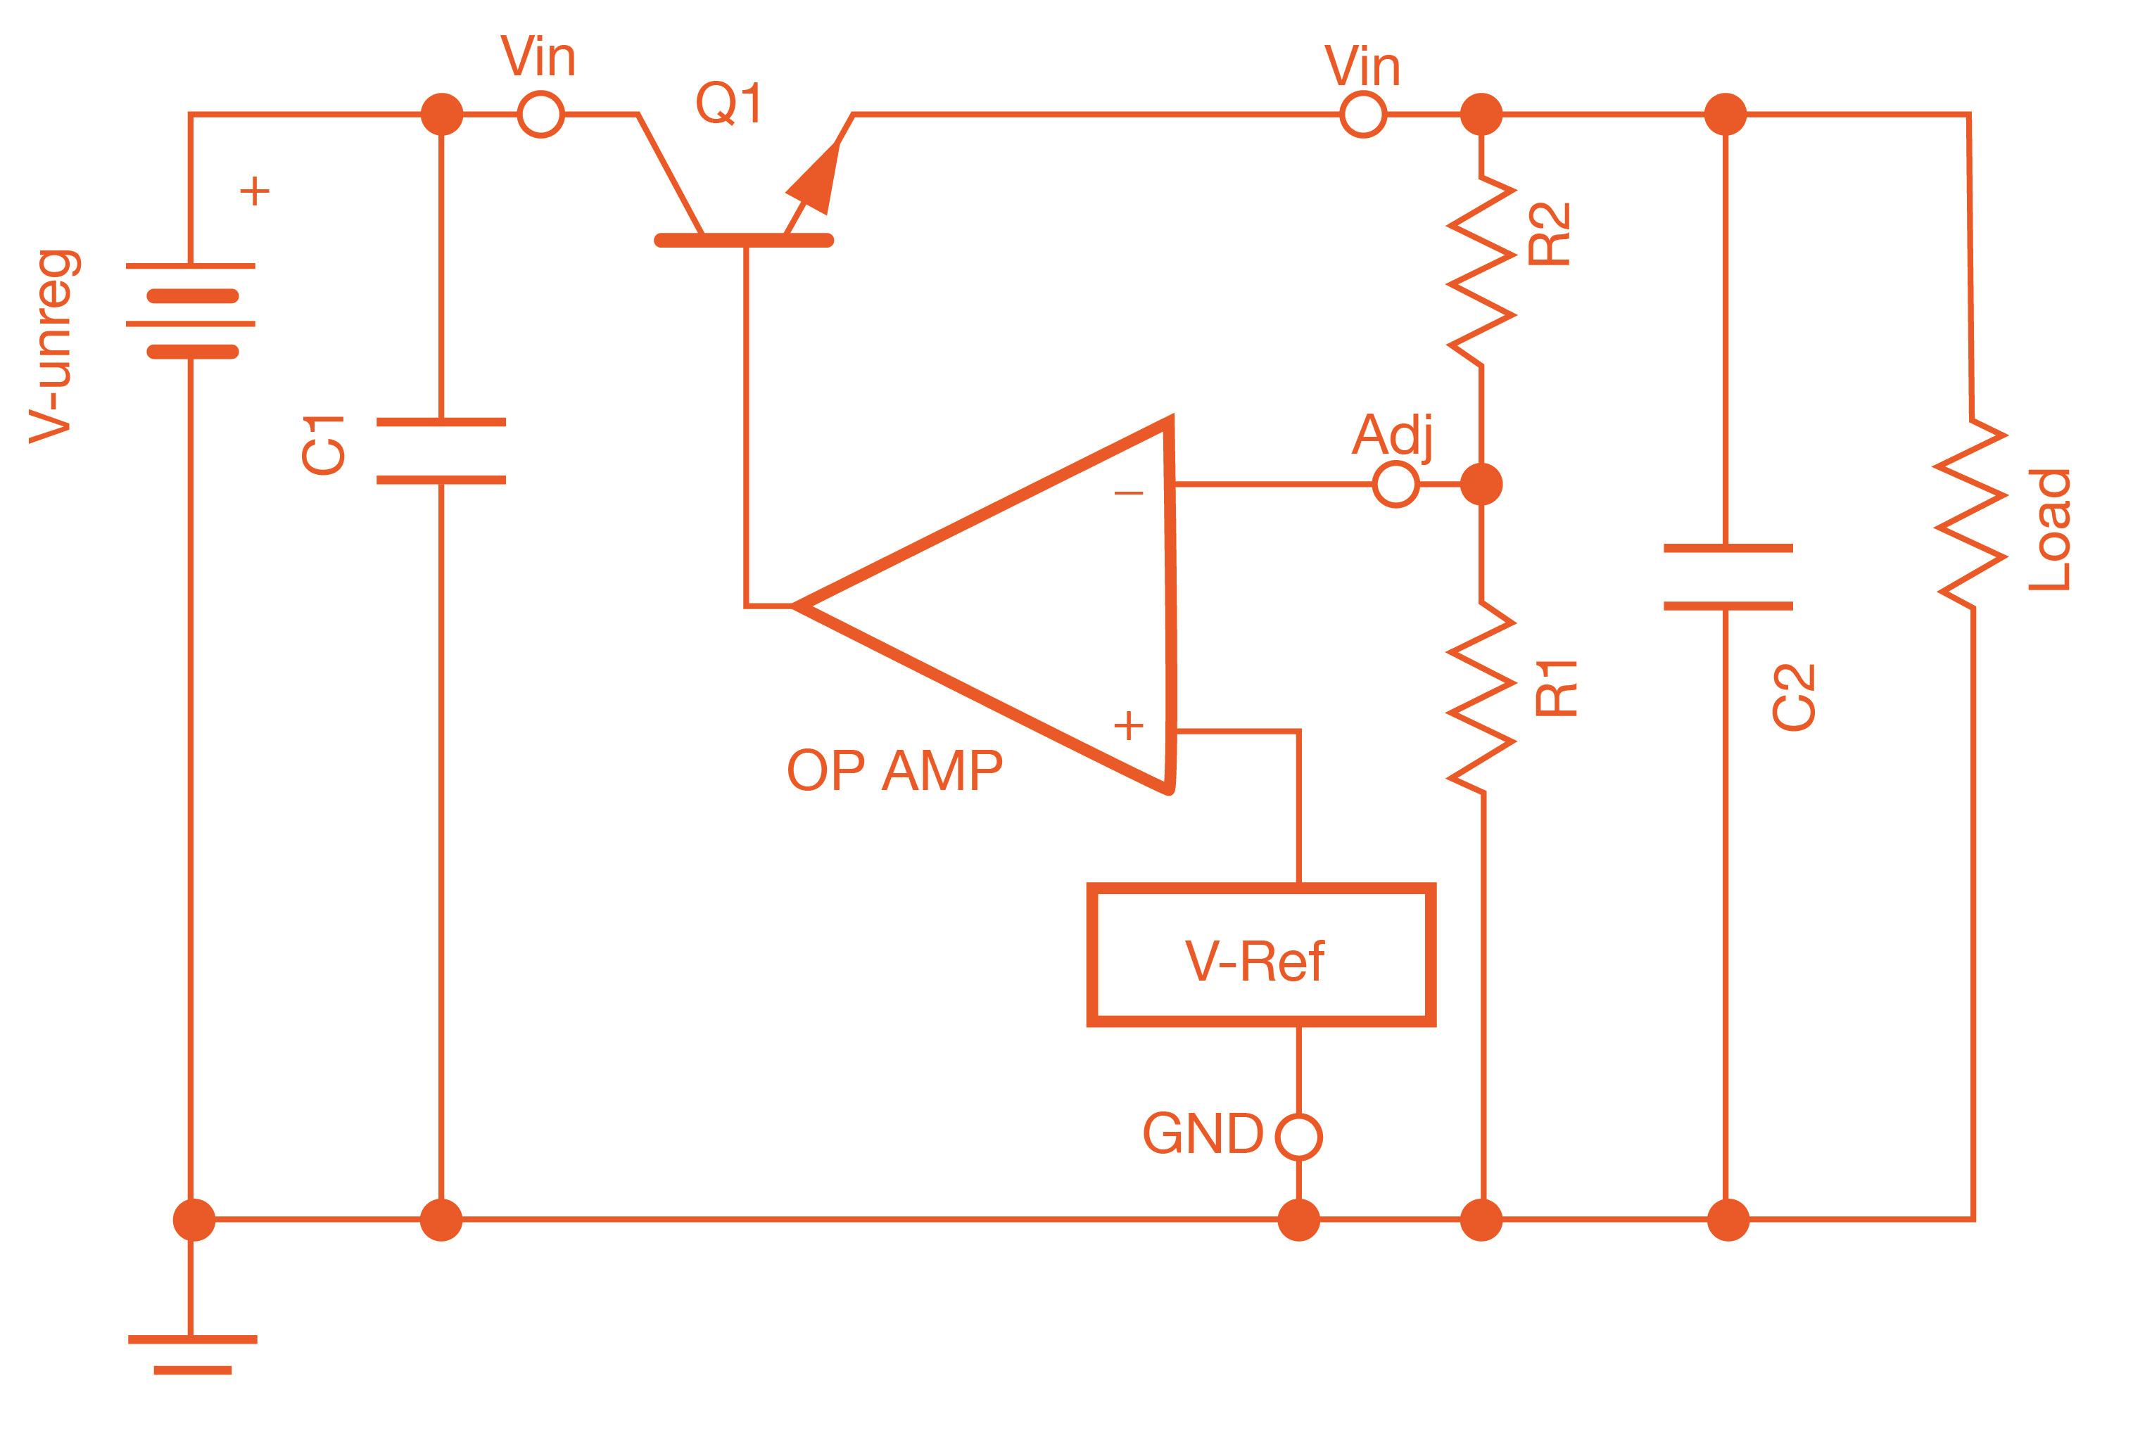
Working Principle
Uses a transistor controlled by an op amp negative feedback circuit
The resistor divider steps down the voltage
The capacitors are used to filter out noise (AC current input)

Slide 4
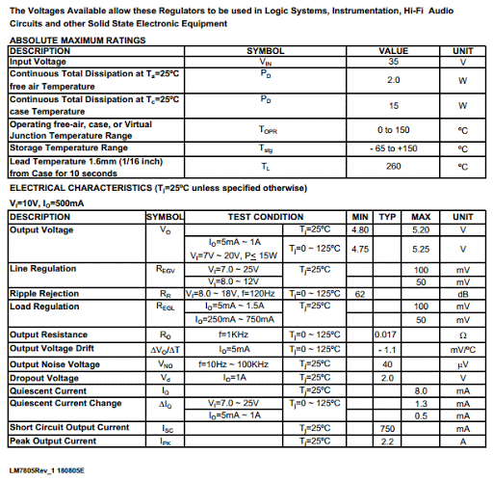
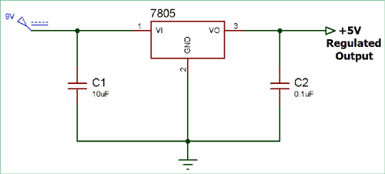
Considerations
There is a minimum difference between the input voltage and the desired output voltage called the dropout voltage (check datasheet dropout value)
If the desired output voltage is too high, then the input voltage must be raised in order maintain the output voltage
Might need external capacitors to guarantee stability (check datasheet for capacitance value)

Slide 5
Considerations
If the difference between the input voltage and output voltage is too high, the regulator will get hot because the excess energy is dissipated as heat
Use a heatsink to protect the regulator
Modern regulators will shut down after reaching a certain temperature (check datasheet for this value)

Slide 6
Difference between Buck converters
Linear voltage regulators are cheaper and easier to use than buck converters
However, they are less efficient and product more heat
Buck converters have a variable output voltage based on the clock signal duty cycle while linear voltage regulators have a fixed output voltage
Linear voltage regulators do not use coils, so they do not create electromagnetic interference

Slide 7
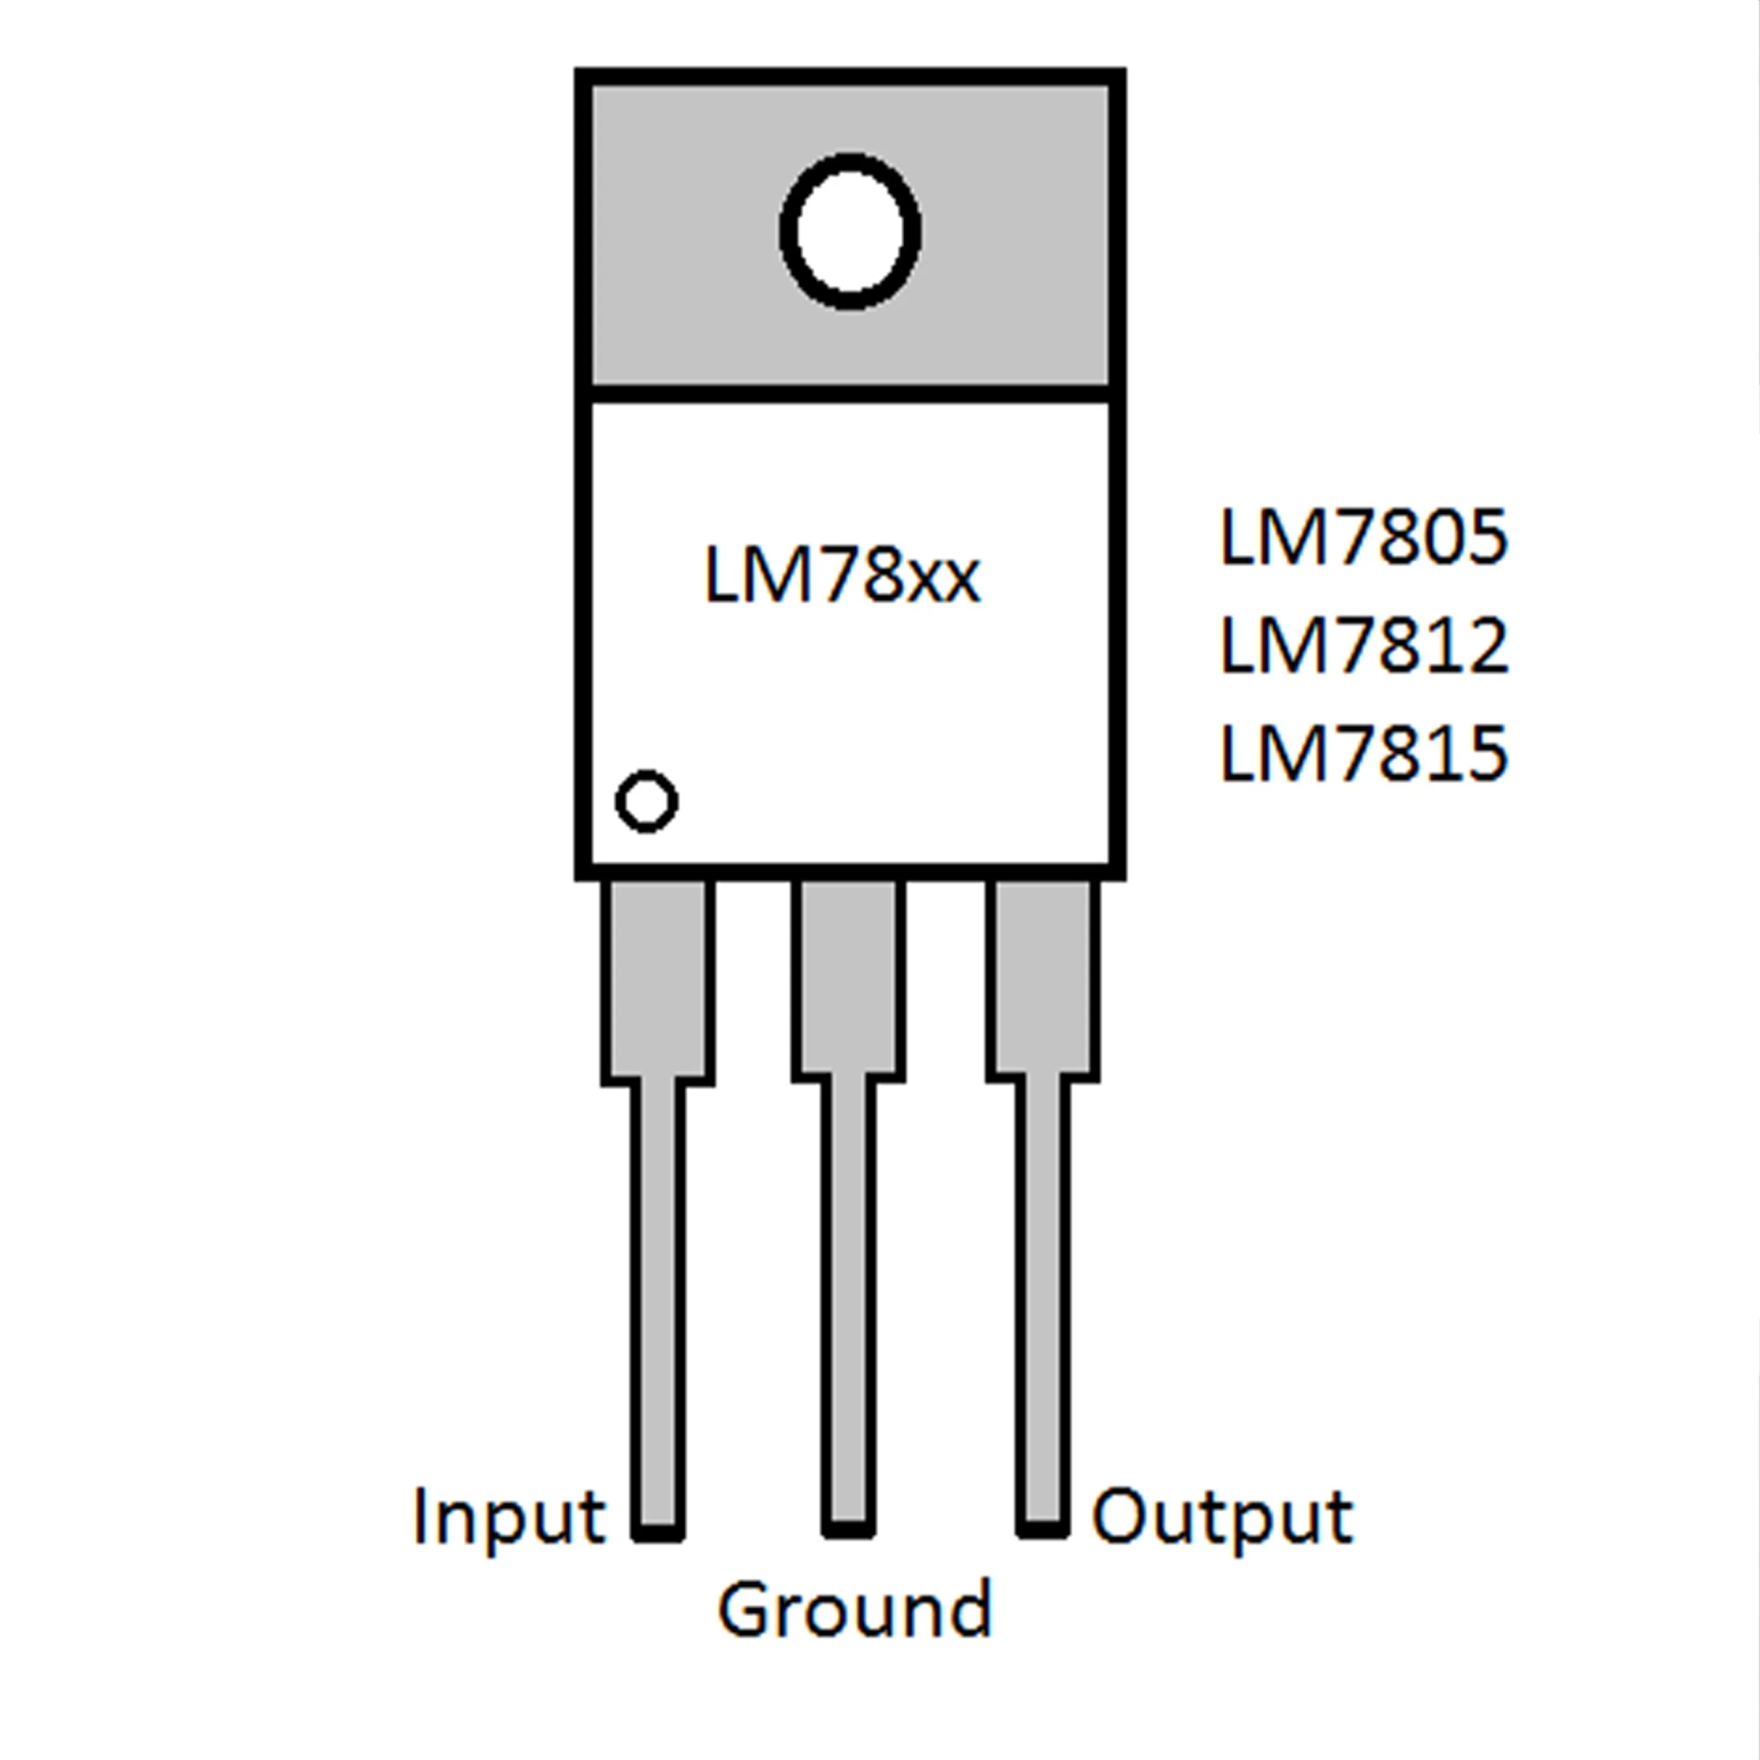
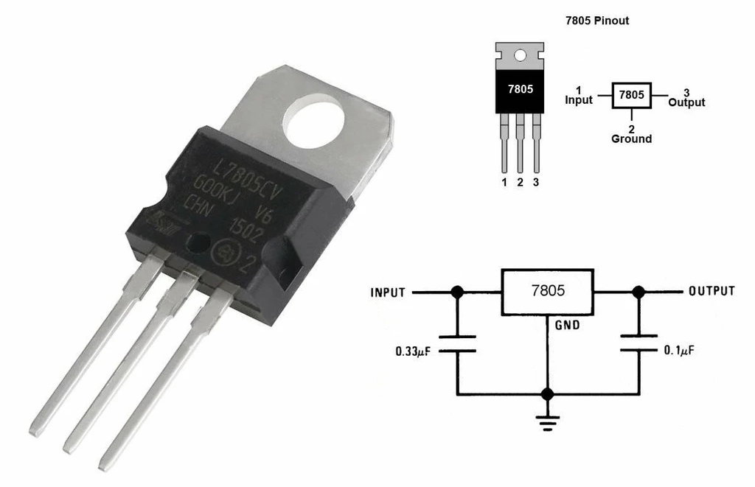
Common linear voltage regulator
LM7805
Other LM 78 series
The last 2 digits represent the output voltage of the regulator i.e. 7805 has a 5V output

