Slide 1
Schottky Diode
GT ECE academic lab
Slides by Zachary Chan

Slide 2
Overview
Similar to regular PN junction diodes (only allows current to flow in one direction)
Has advantages and disadvantages
Very useful for switch mode power supplies
Very efficient

Slide 3
Advantages
Fast switching action
PN junction struggle to block reverse current when a high frequency (100kHz) is applied
Schottky diodes can handle frequencies well beyond 100kHz
Good for high frequency applications such as switch mode power supplies like boost and buck converters
Low voltage drop
Higher efficiency than regular PN junction diodes
Does not generate as much heat as PN junction diodes

Slide 4
Disadvantages
Higher reverse leakage current
When reverse biased, Schottky diodes allow more current to flow than PN junction diodes which can damage the circuit
Generally costs more

Slide 5
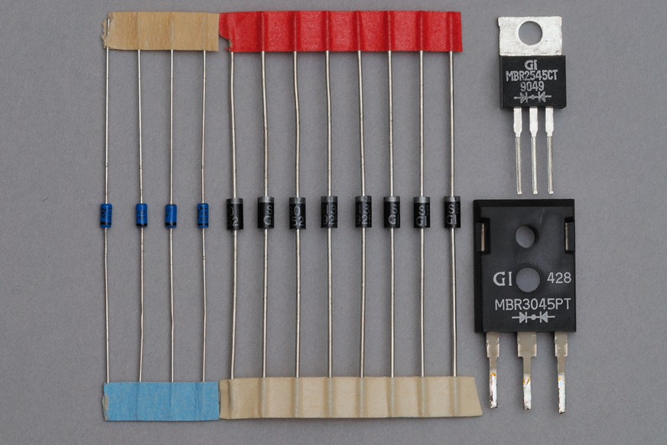
Component

