Slide 1
Servo Motor
GT ece Academic Labs
Slides by helen yoo

Slide 2
What is a Servo?
A rotary motor that utilizes an electrical signal (AC or DC) to precisely control rotational or linear speed and position
DC Servos are more common!

Slide 3
Inside the servo motor

Slide 4
How do servos work?
As motor rotates, the resistance of the potentiometer changes which regulates the amount of movement and the direction.
Power stops when desired position is reached
Proportional Control:
Speed is proportional to
the desired and actual position,
making it very efficient.

Slide 5
How is the servo controlled?
Pulse Width Modulation (PWM) – sending electrical pulse with various variable width
Servo rotates -90, 0, and 90 degrees (total of 180 degrees of movement)
Degree of rotation dependent on pulse with of square wave

Slide 6
Connecting servo via Arduino
Remember to import <Servo.h> in code
Connect black wire to GRND
Connect red wire to 5V
Connect white or yellow wire to any Digital pin

Slide 7
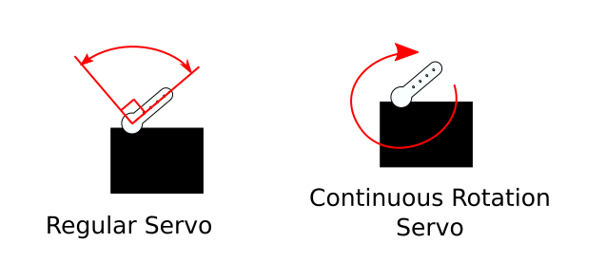
Types of servos
AC vs DC
DC Servos are more common!
Type of Motor inside
Hobbyist vs Industrial
Hobbyist: More for simpler projects such as robot arms as it is smaller and lighter
Industrial: More heavy duty with smaller errors, requires higher voltage to power
Degree of Rotation (180, 360)

Slide 8
Continuous Rotation Servo
Able to rotate a complete 360 degrees continuously
Precision in direction and speed of rotation
Done by removing the potentiometer inside the regular servo and using an encoder that will set an angle but will rotate continuously

Slide 9
Continuous Rotation Servo PWM
Change in pulse wave changes the direction of the servo motor

Slide 10
APPLICATIONS

