Slide 1
Temperature Sensor
GT ECE Academic labs
Slides by Zachary chan

Slide 2
Overview
There are many types of temperature sensors
Even within each temperature sensor type, there are subtypes
Each sensor and their subtypes have different advantages and disadvantages
Research should be done to determine the best type of sensor that should be used for your specific application

Slide 3
Resistance temperature detectors (RTD)
Device made of metal that linearly increases in resistance as temperature increases within a certain operational range
2, 3, and 4 wire types – more wires means more accurate
2 wire less accurate because of the resistance of the wires (temp. will read higher than it actually is)
3 wire is most common for industrial applications and use a Wheatstone bridge to account for the resistance of the copper wires
4 wire can compensate for copper wire resistance even better with a more accurate Wheatstone bridge

Slide 4
Thermistors
Similar to RTD in that heating causes increase in resistance
However, thermistors use semiconductors that have nonlinear resistance-temperature curve because they’re made of polymer or ceramic material
Two types:
Negative Temp. Coefficient (NTC) resistance decreases as temperature increases
Often used as inrush current limiters
Positive Temp. Coefficient (PTC) resistance increases as temperature increases
Often used in overcurrent protection and resettable fuses

Slide 5
Thermocouple
Works using the Thermoelectric Effect: two different metal wires connect at two junctions. When one junction is heated, a potential difference is created between the junctions, and the potential difference can be measured and correlated to temperature
Many different types because there are many different metal combinations, creating different temperature ranges and tolerances
Some common types:
Type K: Nickel-Chromium/Nickel-Alumel, range of -270 to 1260 C,
Type J: Iron-Constantan, range of -210 to 760 C

Slide 6
Semiconductor based IC
Semiconductor based ICs can be local or remote digital: local means it detects changes in an internal transistor and remote means it detects changes in an external transistor
Local temperature sensors can have analog or digital outputs: analog outputs can be voltage or current while digital outputs have a variety of formats
Remote digital temperature sensors have digital outputs

Slide 7
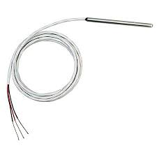
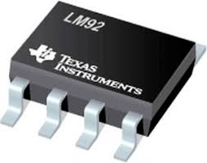
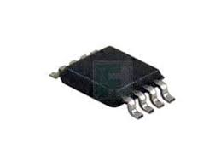
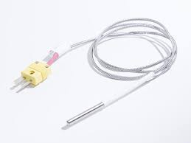
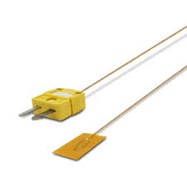
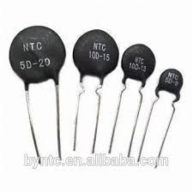
What they look like
RTD
Semiconductor ICs
Thermocouples
Thermistors

Slide 8
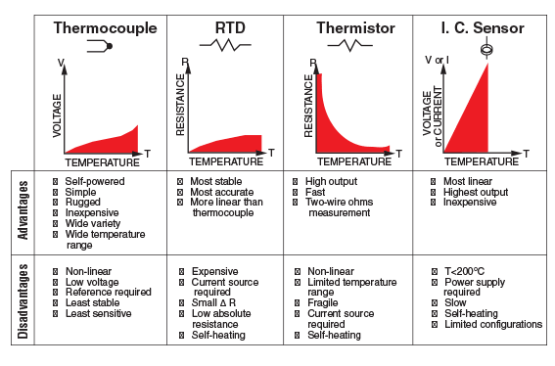
Advantage-Disadvantage Table

