Slide 1
Zener Diode
GT ECE academic lab
Slides by Zachary Chan

Slide 2
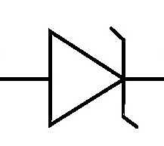
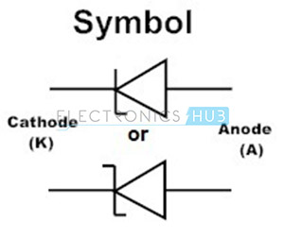
Overview
Allows current to flow in both directions, differentiating Zener diodes from regular diodes
Reverse voltage drop is higher than forward voltage drop
Can be used for crude voltage regulators
Better used to clip the voltage
These are different symbols from different engineering standards

Slide 3
Reverse Bias condition
When a specific reverse voltage level is reached, known as the Zener voltage, the Zener diode begins to allow current the flow
The current through the diode is determined by a resistor in series to the power supply
The voltage drop across the diode is equal to the Zener voltage
If the supply were 15V alternating current, then the Zener diode would drop 12.6V in reverse bias (as shown) and drop a much smaller value (let’s say 0.3V) in forward bias (like a regular diode), so the diode does not rectify like regular diodes do

Slide 4
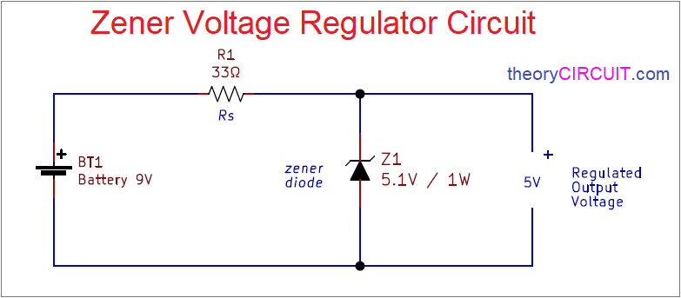
Crude Voltage regulator
If the load has a maximum voltage limit, a Zener diode can be placed in parallel in a reverse bias direction
A resistor can be placed in series to the supply to reduce the current in order to protect the diode
The resistor value depends on the maximum current that can flow through the Zener diode

Slide 5
Crude Voltage regulator
The Zener voltage is the reverse bias voltage drop
If the supply voltage is higher than the Zener voltage, the Zener diode becomes fully reverse biased and has a voltage drop equal to the Zener voltage
This limits the load’s max voltage drop to the Zener voltage

Slide 6
Failure Point
The voltage drop across the Zener diode changes wildly depending on the current through the diode and temperature of the diode
If the current or temperature are too low or too high, then the Zener diode no longer accurately regulates the voltage
SMPS or linear voltage regulators are a better choice to keep a steady voltage

Slide 7
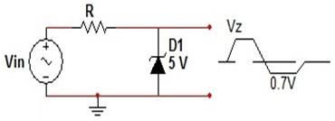
Other (better) applications
Voltage clamping/Waveform clipping
Provides overvolt protection for circuits
Cuts off any voltages over the Zener voltage which creates a flattened waveform
Voltage clamping

