Slide 1
Brushless DC Motor
GT ECE academic lab
Slides by Mark Orban

Slide 2
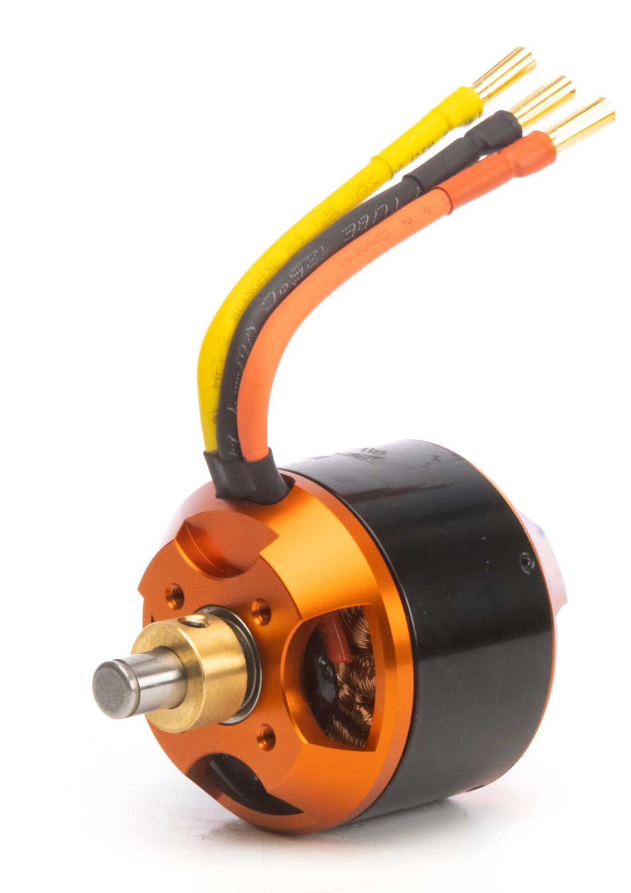
What is a Brushless Motor
A synchronous motor using a switching power supply
Controlled via an electronic speed controller (ESC) circuit
Smaller and lighter than equivalent brushed DC motors

Slide 3
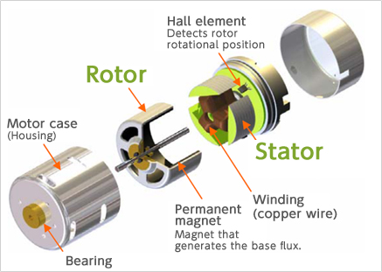
Outer Rotor type
Advantages:
Easy to obtain large torque.
Speed is stable during constant rotation.
Disadvantages:
The rotor is large (the motion is slow).
The outside rotor requires appropriate safety measures.
Source: https://www.nidec.com/en/technology/capability/brushless/

Slide 4
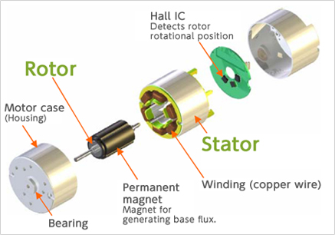
Inner Rotor Type
Advantages:
The rotor is small and can respond quickly.
The coil is located on the outside and the level of heat dissipation is high.
Disadvantages:
Difficult to obtain large torque.
Magnets can be damaged by centrifugal force.
Source: https://www.nidec.com/en/technology/capability/brushless/

Slide 5
Brushless vs Brushed
Brushless has three wires vs two for brushed
Brushless doesn't have the constant arcing of the brushed commutator
Generates less RF interference than brushed DC motors

